Slide 1
Analyzing Amazon Sales data
Pranali Dattaram Tatkare

Slide 2
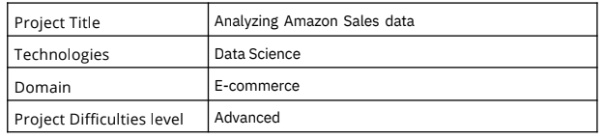

Slide 3
Problem Statement:
Sales management has gained importance to meet increasing competition and the need
for improved methods of distribution to reduce cost and to increase profits. Sales
management today is the most important function in a commercial and business
enterprise.
Do ETL: Extract-Transform-Load some Amazon dataset and find for me
Sales-trend -> month-wise, year-wise, yearly_month-wise
Find key metrics and factors and show the meaningful relationships between
attributes.

Slide 4
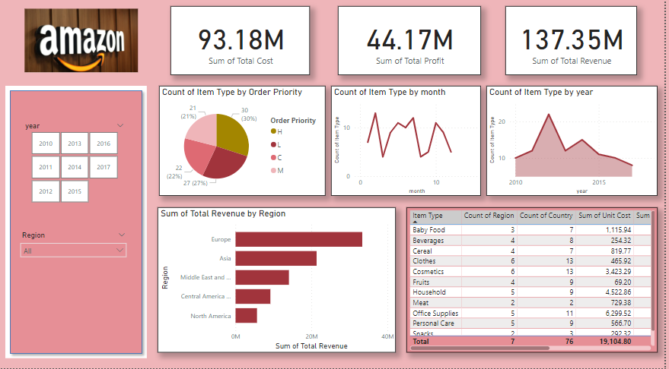

Slide 5
Thank You

